Slide 1
SONET
Ashwini R Ujjinamatada
24th October 2006

Slide 2
What is SONET ?
SONET stands for Synchronous Optical Network.
is a standard for optical telecommunications transport formulated by the Exchange Carriers Standards Association (ECSA) for the American National Standards Institute (ANSI)
It defines optical carrier (OC) levels and electrically equivalent synchronous transport signals (STSs) for the fiber-optic–based transmission hierarchy.

Slide 3
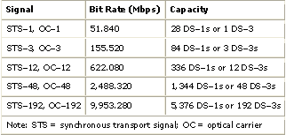
SONET Hierarchy
The lowest level or base signal is referred to as STS -1 i.e. Synchronous Transport Signal level -1 which operates at 51.840Mbps.
Higher-level signals are integer multiples of STS -1.
STS –N signal is composed of N byte-interleaved STS -1 signals.

Slide 4
SONET Layers
Photonic, which corresponds to the OSI's physical layer, defines the optical equipment's attributes (OC-n.)
Section, the frame format and certain low-level signal definitions, roughly corresponding to the OSI link layer.
Line, the way in which lower-level frames are synchronized and combined into higher levels; can be sort of looked as parts of the network and transport layers. The line layer also defines data channels carrying operations, administration, maintenance and provisioning (OAM&P) information, which would be an application layer in an OSI modeled network.
Path, the end-to-end transport of a circuit, which also has application information (performance monitoring, status, tracing) for management.

Slide 5
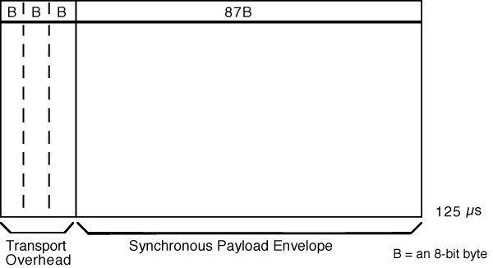
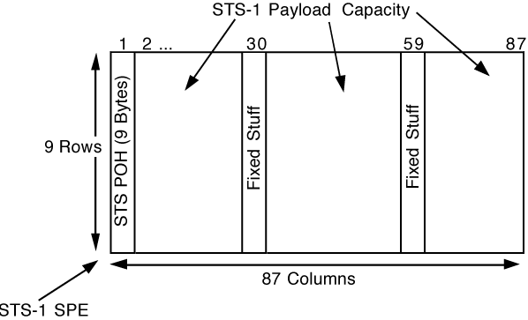
Frame Format Structure
The frame can be divided into two main areas: Transport overhead and Synchronous Payload envelope (SPE).
The SPE can also be divided into two parts: STS path overhead and the payload.
STS -1 Synchronous Payload
Envelope (SPE)
STS -1 Frame Format

Slide 6
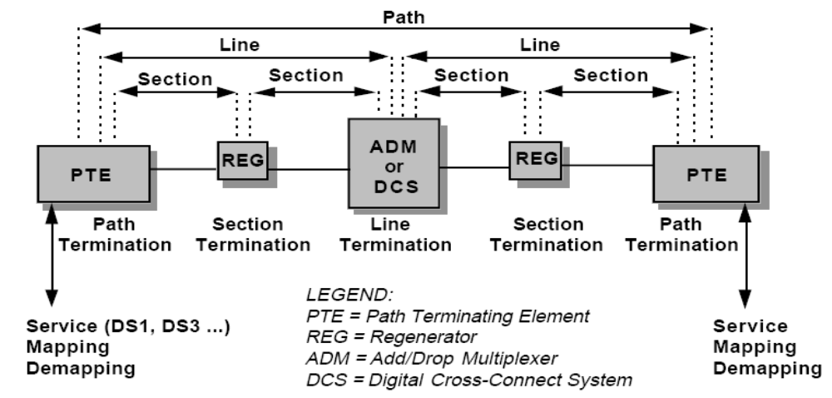
Overhead Layers
Path-level overhead is carried from end-to-end.
Line overhead is for the STS-N signal between STS-N multiplexers.
Section overhead is used for communications between adjacent network elements, such as regenerators.

Slide 7
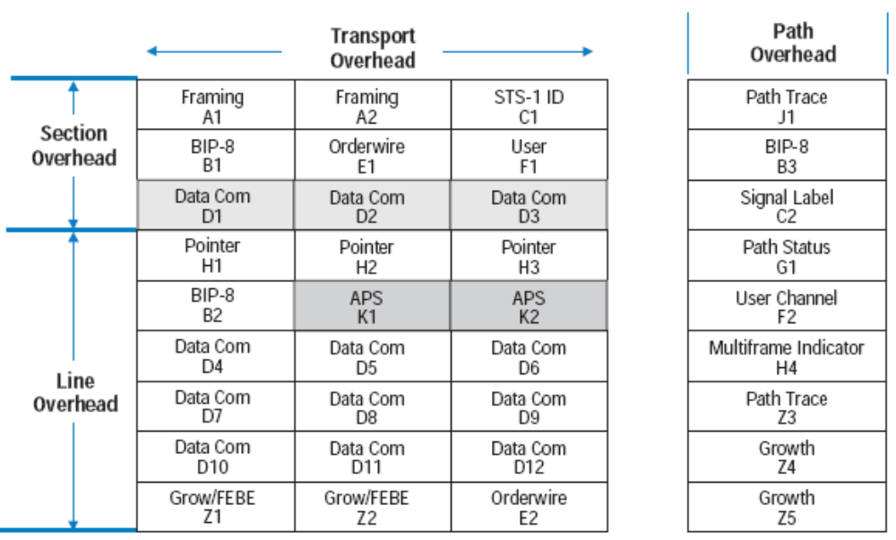
Overheads

Slide 8
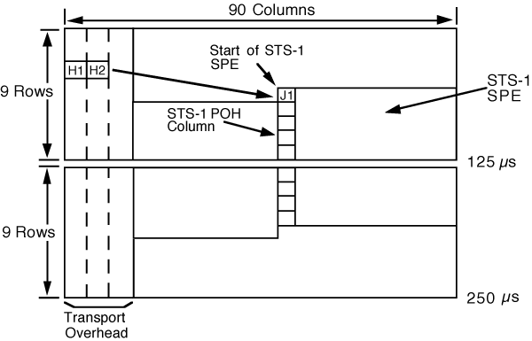
Pointers
Pointer—SPE Position in the
STS–1 Frame
SONET uses a concept called “pointers” to compensate for frequency and phase variations.
i.e. if there are any frequency or phase variations between STS-1 frame and its SPE, the pointer value will be increased or decreased accordingly to maintain synchronization.

Slide 9
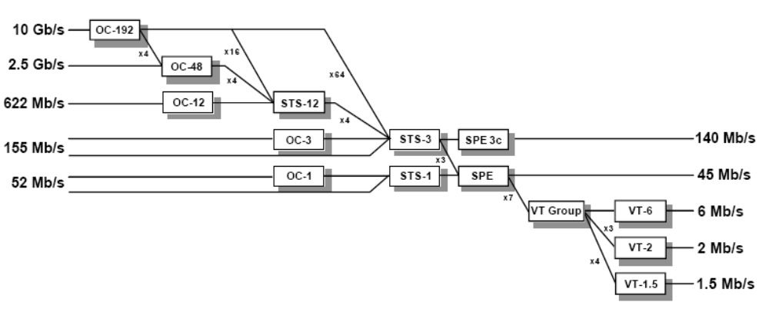
SONET multiplexing Hierarchy
The STS Synchronous Payload Envelope can be sub-divided into smaller components or structures known as Virtual Tributaries (VT’s), for the purpose of transporting and switching payloads smaller than the STS-1 rate.
All services below DS3 rate are transported in the VT structure. The figure illustrates the basic multiplexing structure of SONET.

Slide 10
References:
www.sonet.com
www.tek.com
Thank you.

